Slide 1
UNIVERSITY INSTITUTE OF COMPUTING
MASTER OF COMPUTER APPLICATIONS
Design and Analysis of Algorithms
24CAP-611
UNIT 3
DISCOVER . LEARN . EMPOWER

Slide 2
Travelling Salesman Problem | Branch & Bound
Travelling Salesman Problem-
You are given-
A set of some cities
Distance between every pair of cities
Travelling Salesman Problem states-
A salesman has to visit every city exactly once.
He has to come back to the city from where he starts his journey.
What is the shortest possible route that the salesman must follow to complete his tour?

Slide 3
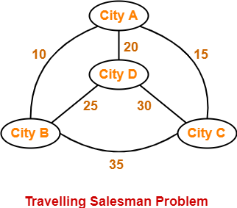
Travelling Salesman Problem
Example-
The following graph shows a set of cities and distance between every pair of cities-

Slide 4
Travelling Salesman Problem
If salesman starting city is A, then a TSP tour in the graph is-
A → B → D → C → A
Cost of the tour
= 10 + 25 + 30 + 15
= 80 units
In this Lecture, we will discuss how to solve travelling salesman problem using branch and bound approach with example.

Slide 5
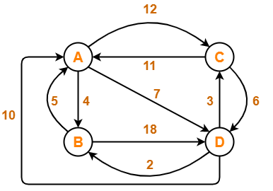
Travelling Salesman Problem
Problem-
Solve Travelling Salesman Problem using Branch and Bound Algorithm in the following graph-

Slide 6
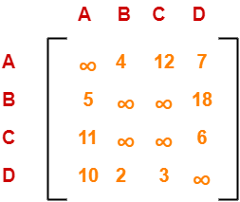
Solution
Step-01:
Write the initial cost matrix and reduce it-
Rules
To reduce a matrix, perform the row reduction and column reduction of the matrix separately.
A row or a column is said to be reduced if it contains at least one entry ‘0’ in it.

Slide 7
Row Reduction
Consider the rows of above matrix one by one.
If the row already contains an entry ‘0’, then-
There is no need to reduce that row.
If the row does not contains an entry ‘0’, then-
Reduce that particular row.
Select the least value element from that row.
Subtract that element from each element of that row.
This will create an e
Following this, we have-
Reduce the elements of row-1 by 4.
Reduce the elements of row-2 by 5.
Reduce the elements of row-3 by 6.
Reduce the elements of row-4 by 2.
Entry ‘0’ in that row, thus reducing that row.

Slide 8
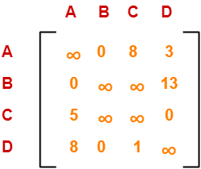
Row Reduction
Performing this, we obtain the following row-reduced matrix.

Slide 9
Column Reduction-
Consider the columns of above row-reduced matrix one by one.
If the column already contains an entry ‘0’, then-
There is no need to reduce that column.
If the column does not contains an entry ‘0’, then-
Reduce that particular column.
Select the least value element from that column.
Subtract that element from each element of that column.
This will create an entry ‘0’ in that column, thus reducing that column.

Slide 10
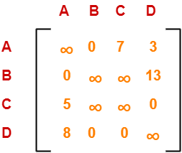
Column Reduction
Following this, we have-
There is no need to reduce column-1.
There is no need to reduce column-2.
Reduce the elements of column-3 by 1.
There is no need to reduce column-4.
Performing this, we obtain the following column-reduced matrix-
Finally, the initial distance matrix is completely reduced.

Slide 11
Column Reduction
Now, we calculate the cost of node-1 by adding all the reduction elements.
Cost(1)
= Sum of all reduction elements
= 4 + 5 + 6 + 2 + 1
= 18
Step-02:
We consider all other vertices one by one.
We select the best vertex where we can land upon to minimize the tour cost.

Slide 12
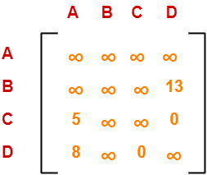
Column Reduction
Choosing To Go To Vertex-B: Node-2 (Path A → B)
From the reduced matrix of step-01, M[A,B] = 0
Set row-A and column-B to ∞
Set M[B,A] = ∞
Now, resulting cost matrix is-
Now,
We reduce this matrix.
Then, we find out the cost of node-02.

Slide 13

Row Reduction-
We can not reduce row-1 as all its elements are ∞.
Reduce all the elements of row-2 by 13.
There is no need to reduce row-3.
There is no need to reduce row-4.
Performing this, we obtain the following row-reduced matrix-

Slide 14
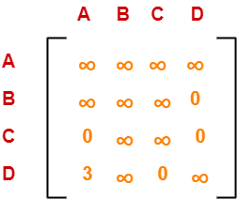
Column Reduction-
Reduce the elements of column-1 by 5.
We can not reduce column-2 as all its elements are ∞.
There is no need to reduce column-3.
There is no need to reduce column-4.
Performing this, we obtain the following column-reduced matrix-
Finally, the matrix is completely reduced.
Now, we calculate the cost of node-2.
Cost(2)
= Cost(1) + Sum of reduction elements + M[A,B]
= 18 + (13 + 5) + 0
= 36

Slide 15
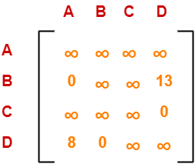
Choosing To Go To Vertex-C: Node-3 (Path A → C)
From the reduced matrix of step-01, M[A,C] = 7
Set row-A and column-C to ∞
Set M[C,A] = ∞
Now, resulting cost matrix is:
Now,
We reduce this matrix.
Then, we find out the cost of node-03.

Slide 16
Row Reduction-
We can not reduce row-1 as all its elements are ∞.
There is no need to reduce row-2.
There is no need to reduce row-3.
There is no need to reduce row-4.
Thus, the matrix is already row-reduced.
Column Reduction-
There is no need to reduce column-1.
There is no need to reduce column-2.
We can not reduce column-3 as all its elements are ∞.
There is no need to reduce column-4.

Slide 17
Column Reduction-
Thus, the matrix is already column reduced.
Finally, the matrix is completely reduced.
Now, we calculate the cost of node-3.
Cost(3)
= Cost(1) + Sum of reduction elements + M[A,C]
= 18 + 0 + 7
= 25

Slide 18
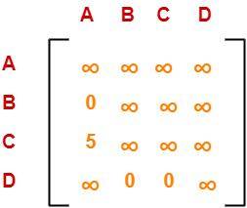
Choosing To Go To Vertex-D: Node-4 (Path A → D)
From the reduced matrix of step-01, M[A,D] = 3
Set row-A and column-D to ∞
Set M[D,A] = ∞
Now, resulting cost matrix is-
Now,
We reduce this matrix.
Then, we find out the cost of node-04.

Slide 19
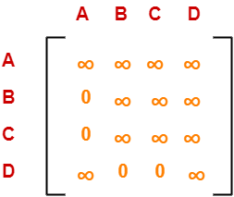
Row Reduction-
We can not reduce row-1 as all its elements are ∞.
There is no need to reduce row-2.
Reduce all the elements of row-3 by 5.
There is no need to reduce row-4.
Performing this, we obtain the following row-reduced matrix-
Column Reduction-
There is no need to reduce column-1.
There is no need to reduce column-2.
There is no need to reduce column-3.
We can not reduce column-4 as all its elements are ∞.

Slide 20
Column Reduction
Thus, the matrix is already column-reduced.
Finally, the matrix is completely reduced.
Now, we calculate the cost of node-4.
Cost(4)
= Cost(1) + Sum of reduction elements + M[A,D]
= 18 + 5 + 3
= 26
Thus, we have-
Cost(2) = 36 (for Path A → B)
Cost(3) = 25 (for Path A → C)
Cost(4) = 26 (for Path A → D)
We choose the node with the lowest cost.
Since cost for node-3 is lowest, so we prefer to visit node-3.
Thus, we choose node-3 i.e. path A → C.

Slide 21
Step-03:
We explore the vertices B and D from node-3.
We now start from the cost matrix at node-3 which is-
Cost(3) = 25

Slide 22
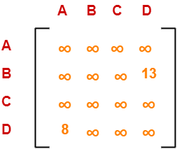
Choosing To Go To Vertex-B: Node-5 (Path A → C → B)
From the reduced matrix of step-02, M[C,B] = ∞
Set row-C and column-B to ∞
Set M[B,A] = ∞
Now, resulting cost matrix is-
Now,
We reduce this matrix.
Then, we find out the cost of node-5.

Slide 23
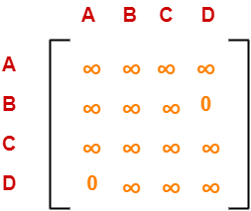
Row Reduction-
We can not reduce row-1 as all its elements are ∞.
Reduce all the elements of row-2 by 13.
We can not reduce row-3 as all its elements are ∞.
Reduce all the elements of row-4 by 8.
Performing this, we obtain the following row-reduced matrix-

Slide 24
Column Reduction-
There is no need to reduce column-1.
We can not reduce column-2 as all its elements are ∞.
We can not reduce column-3 as all its elements are ∞.
There is no need to reduce column-4.
Thus, the matrix is already column reduced.
Finally, the matrix is completely reduced.
Now, we calculate the cost of node-5.
Cost(5)
= cost(3) + Sum of reduction elements + M[C,B]
= 25 + (13 + 8) + ∞
= ∞

Slide 25
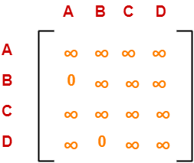
Choosing To Go To Vertex-D: Node-6 (Path A → C → D)
From the reduced matrix of step-02, M[C,D] = ∞
Set row-C and column-D to ∞
Set M[D,A] = ∞
Now, resulting cost matrix is-
Now,
We reduce this matrix.
Then, we find out the cost of node-6.

Slide 26
Row Reduction
We can not reduce row-1 as all its elements are ∞.
There is no need to reduce row-2.
We can not reduce row-3 as all its elements are ∞.
We can not reduce row-4 as all its elements are ∞.
Thus, the matrix is already row reduced.
Column Reduction-
There is no need to reduce column-1.
We can not reduce column-2 as all its elements are ∞.
We can not reduce column-3 as all its elements are ∞.
We can not reduce column-4 as all its elements are ∞.

Slide 27
Row Reduction
Thus, the matrix is already column reduced.
Finally, the matrix is completely reduced.
Now, we calculate the cost of node-6.
Cost(6)
= cost(3) + Sum of reduction elements + M[C,D]
= 25 + 0 + 0
= 25
Thus, we have-
Cost(5) = ∞ (for Path A → C → B)
Cost(6) = 25 (for Path A → C → D)
We choose the node with the lowest cost.
Since cost for node-6 is lowest, so we prefer to visit node-6.
Thus, we choose node-6 i.e. path C → D.

Slide 28
Step-04:
We explore vertex B from node-6.
We start with the cost matrix at node-6 which is-
Choosing To Go To Vertex-B: Node-7 (Path A → C → D → B)
From the reduced matrix of step-03, M[D,B] = 0
Set row-D and column-B to ∞
Set M[B,A] = ∞
Now, resulting cost matrix is-

Slide 29
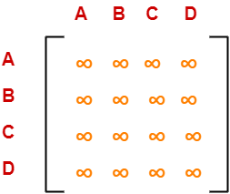
Step-4
Now,
We reduce this matrix.
Then, we find out the cost of node-7.
Row Reduction-
We can not reduce row-1 as all its elements are ∞.
We can not reduce row-2 as all its elements are ∞.
We can not reduce row-3 as all its elements are ∞.
We can not reduce row-4 as all its elements are ∞.

Slide 30
Column Reduction-
We can not reduce column-1 as all its elements are ∞.
We can not reduce column-2 as all its elements are ∞.
We can not reduce column-3 as all its elements are ∞.
We can not reduce column-4 as all its elements are ∞.
Thus, the matrix is already column reduced.
Finally, the matrix is completely reduced.
All the entries have become ∞.
Now, we calculate the cost of node-7.
Cost(7)
= cost(6) + Sum of reduction elements + M[D,B]
= 25 + 0 + 0
= 25
Thus,
Optimal path is: A → C → D → B → A
Cost of Optimal path = 25 units

Slide 31
1) https://www.tutorialspoint.com/data_structures_algorithms/divide_and_conquer.htm 2) Data Structures and Algorithms made easy By Narasimha Karumanchi. 3) The Algorithm Design Manual, 2nd Edition by Steven S Skiena 4) Fundamentals of Computer Algorithms - Horowitz and Sahani
References

Slide 32
THANK YOU

